Slide 2

Module 1_ Entrepreneurial Fundamentals

Slide 3

Introduction to Entrepreneurship: Definitions, Scope, and Key Characteristics

Slide 4
What is Entrepreneurship?

Slide 5
Entrepreneurship is the process by which individuals or groups identify a business opportunity, gather resources, and take risks to create value, often through innovation or problem-solving.

Slide 6
Key Characteristics
Innovation and Creativity
Entrepreneurs develop new ideas, products, or services that challenge the status quo.
Example: The creation of Airbnb, which disrupted the traditional hotel industry.

Slide 7

What is Innovation? by David Brier

Slide 8
Key Characteristics
Risk-taking
Entrepreneurs take calculated risks, balancing potential gains with possible losses.
Example: Launching a startup often involves financial risks without guaranteed success.

Slide 9
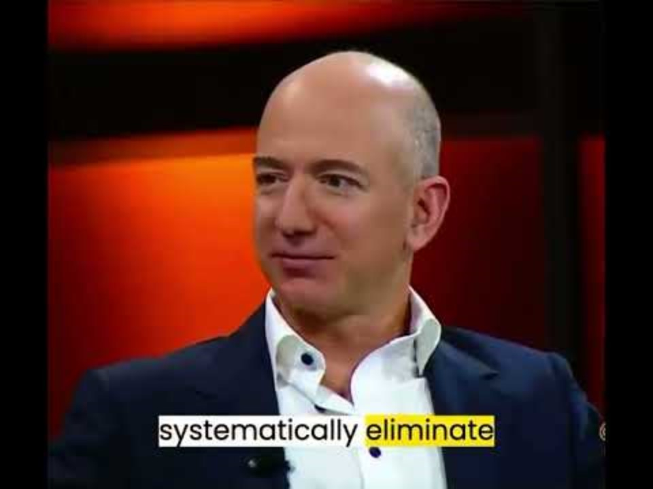
Risk taking and entrepreneurship by Jeff Bezos

Slide 10
Key Characteristics
Value Creation
Entrepreneurship is about generating value, either in monetary terms or through social impact.
Example: Social entrepreneurs creating businesses that solve environmental or community issues.

Slide 11
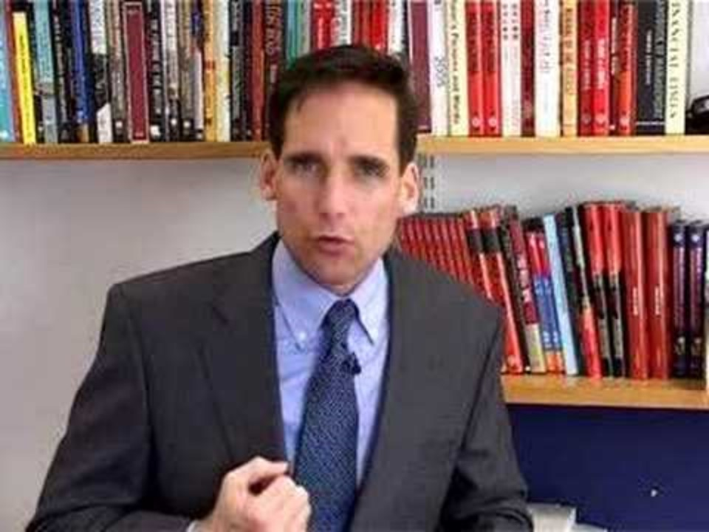
Simple rules: Three logics of value creation by London Business School

Slide 12
Who is an Entrepreneur?

Slide 13
An entrepreneur is someone who identifies opportunities and turns them into ventures that generate value, often by overcoming significant obstacles.

Slide 14
Characteristics of a successful entrepreneur include
Visionary Thinking
Entrepreneurs can foresee market needs and future trends

Slide 15
Characteristics of a successful entrepreneur include
Resilience
Entrepreneurship often involves failure and setbacks, but resilience helps entrepreneurs keep going.

Slide 16
Scope of Entrepreneurship

Slide 17

Scope of Entrepreneurship
Entrepreneurship is not limited to starting businesses—it spans a wide range of sectors and activities. It includes creating innovative solutions in diverse fields.
Mr. A. K. Dwivedi

Slide 18
Areas of Entrepreneurship
Technology
Startups and innovations in software, hardware, and digital platforms.

Slide 19
Areas of Entrepreneurship
Social Entrepreneurship
Ventures that address societal challenges, such as poverty, education, or healthcare.

Slide 20
Areas of Entrepreneurship
Traditional Businesses
Brick-and-mortar businesses like restaurants, retail stores, or manufacturing firms.

Slide 21
Areas of Entrepreneurship
Green and Sustainable Entrepreneurship
Ventures focused on sustainability and environmental solutions.

Slide 22
References
Investopedia. (n.d.). Entrepreneur. Investopedia. https://www.investopedia.com/terms/e/entrepreneur.asp#:~:text=Entrepreneurship%20is%20when%20an%20individual,with%20an%20innovative%20new%20idea.
Rezaei, S., & Katsushi, T. (2020). Understanding the definition of entrepreneurship. ResearchGate. https://www.researchgate.net/publication/343853006_Understanding_Definition_of_Entrepreneurship
Investopedia. (n.d.). Entrepreneur. Investopedia. https://www.investopedia.com/terms/e/entrepreneur.asp

Slide 23
Thank You!
This document reflects the views only of the authors, and the European Commission cannot be held responsible for any use which may be made of the information contained. Find out more about Erasmus+ at https://erasmus-plus.ec.europa.eu/

